Slide 1
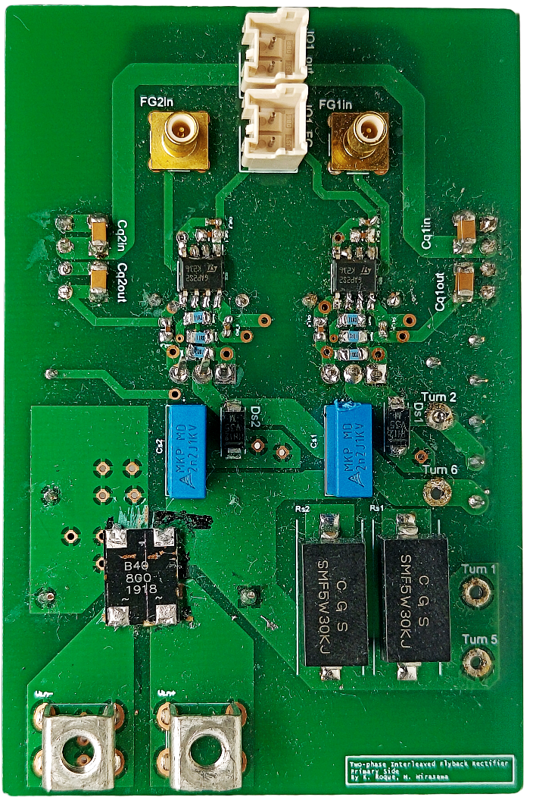
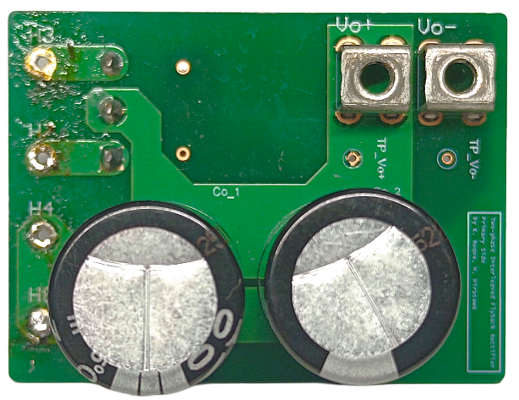
57.50 mm
58.00 mm
87.75 mm
43.00 mm
Primary Side
Secondary Side

Slide 2
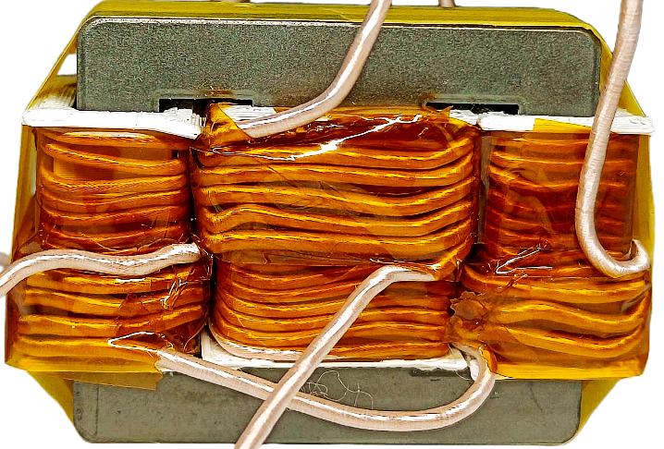


58.80 mm
$\frac{\text{1}}{\text{2}}$ N₁₂
39.70 mm
$\frac{\text{1}}{\text{2}}$ N₃₄
N₅₆
N₇₈

